Slide 1
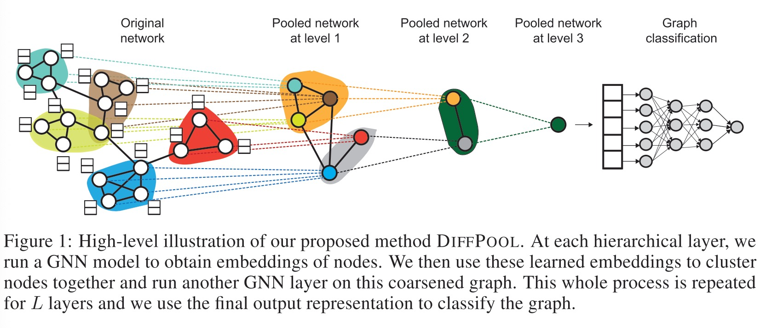
Hierarchical Graph Representation Learning with Differentiable Pooling
Challenge: When applying GNNs to graph classification, the standard approach is to generate embeddings for all the nodes in the graph and then to globally pool all these node embeddings together. This global pooling approach ignores any hierarchical structure that might be present in the graph, and it prevents researchers from building effective GNN models for predictive tasks over entire graphs

Slide 2




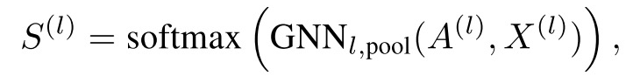
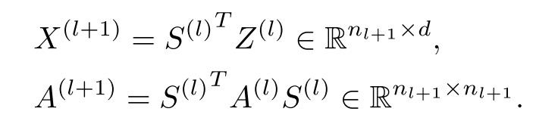


GNN
Pooling
Cluster assignment matrix at layer l as
Auxiliary Link Prediction Objective and Entropy Regularization
Nearby nodes should be pooled together
Output cluster assignment for each node should generally be close to a one-hot vector

Slide 3
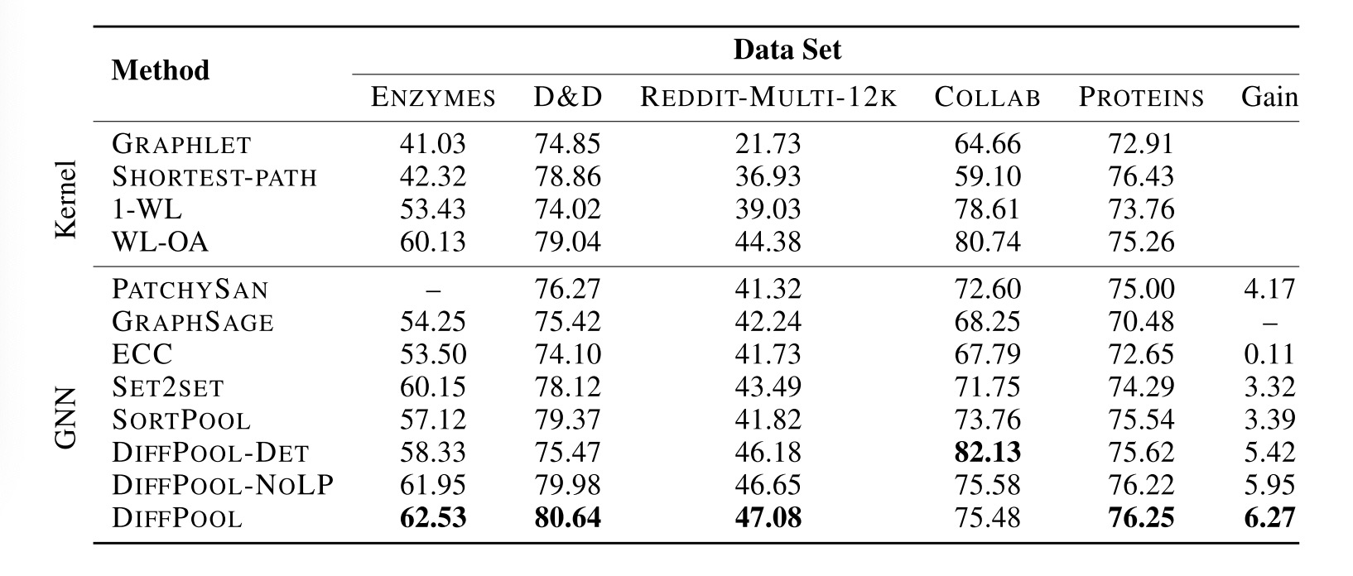
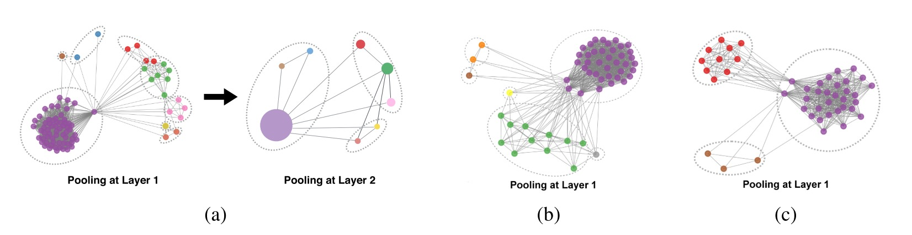

Slide 4
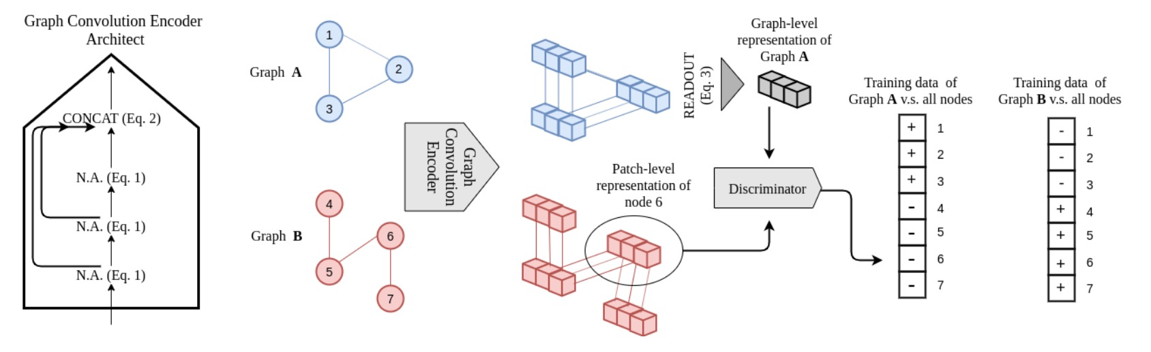
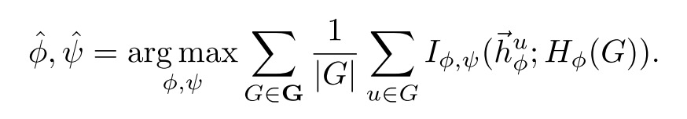
InfoGraph: Unsupervised and Semi-supervised Graph-Level Representation Learning via Mutual Information Maximization
Motivation:
InfoGraph (unsupervised): Maximize the mutual information between the representations of entire graphs and the representations of substructures of different granularity
InfoGraph* (semi-supervised): Maximize the mutual information between intermediate representations of the two models so that the student model (supervised) learns from the teacher model (unsupervised).
* Graph neural network designs should be considered carefully so that graph representations can be discriminative towards other graph instances.

Slide 5
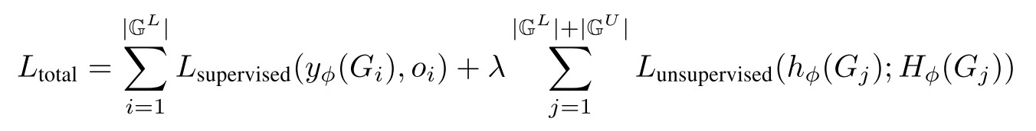
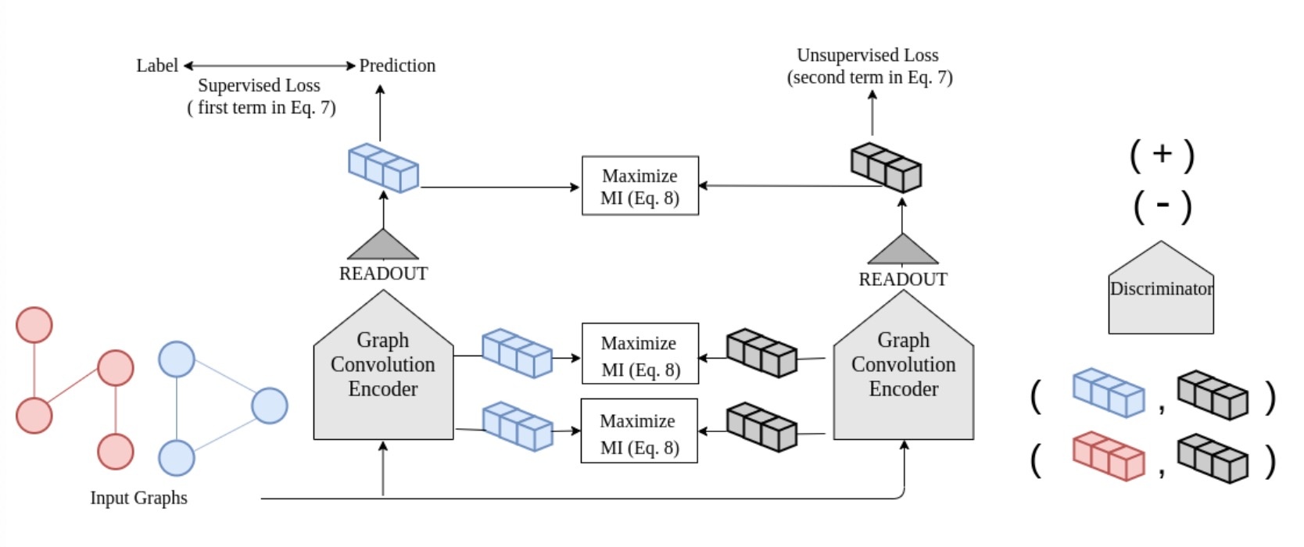
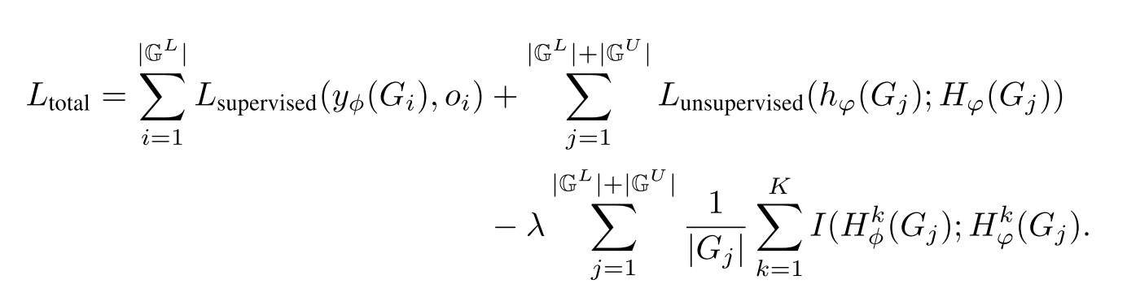
Negative transfer

Slide 6
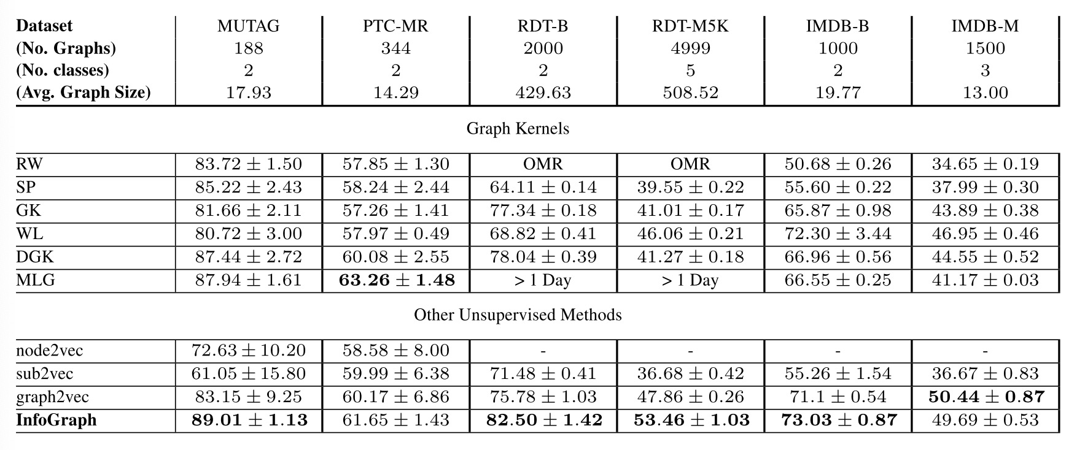
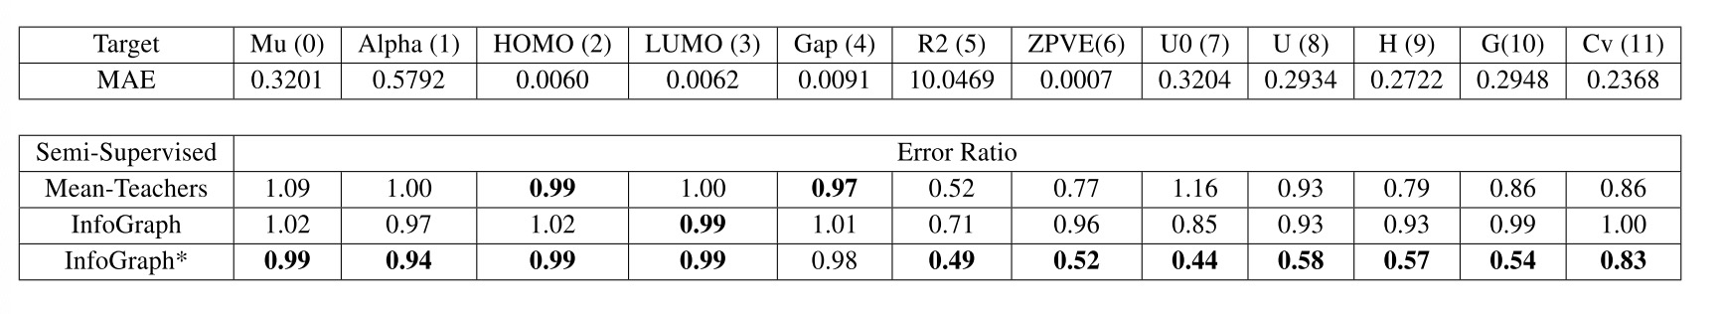

Slide 7
Application in Urban Computing
Wang, Pengyang, et al. "Adversarial substructured representation learning for mobile user profiling." Proceedings of the 25th ACM SIGKDD International Conference on Knowledge Discovery & Data Mining. 2019
Wang, Pengyang, et al. "You are how you drive: Peer and temporal-aware representation learning for driving behavior analysis." Proceedings of the 24th ACM SIGKDD International Conference on Knowledge Discovery & Data Mining. 2018.

